Slide 1





Data Warehouse/Data Mart
It’s all about the data

Slide 2

Data Warehouse/Data Mart
Integrate data across functions or systems
Reorganize data to support fast reporting and querying
Clean up data to provide quality, consistent and integrity

Slide 3


Data Warehouse/Data Mart
“...the father of Data Warehousing…”
“…one of the original architectures of Data Warehousing…”

Slide 4
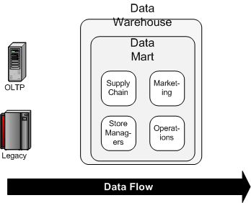
Data Warehouse /Data Mart
Ralph Kimball’s design model
The Data Warehouse Bus Structure: bottom-down approach
Data Warehouse and Data Marts connected by a bus structure

Slide 5
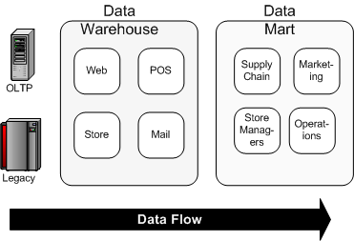
Data Warehouse/Data Mart
The Dependent Data Mart: top-down approach
Bill Inmon’s design model
Data should be organized into subject-oriented, integrated, non-volatile, time-variant structures

Slide 6
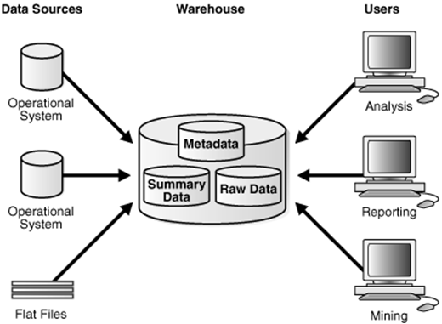
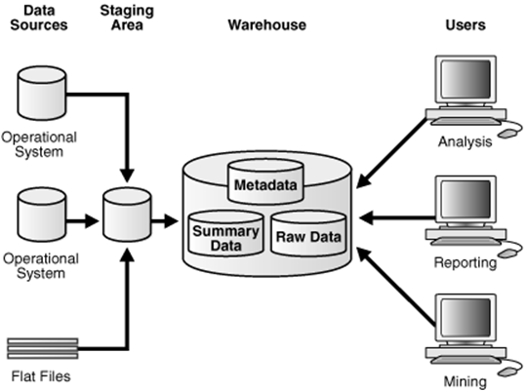
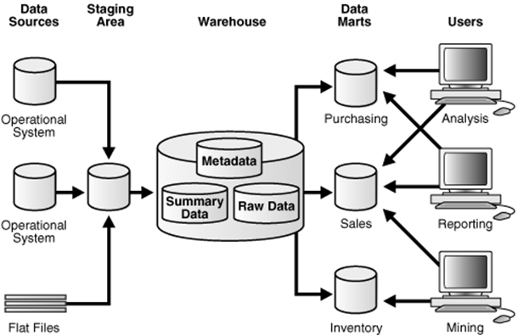
Data Flow

Slide 7

Data Mart
simple form of a data warehouse that is focused on a single subject, such as Finance, Sales, or Marketing

Slide 8
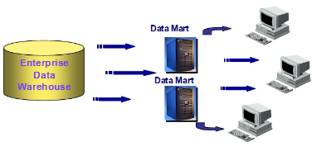
Data Mart
Data mart has specific business-related purposes, such as measuring and forecasting sales performance

Slide 9
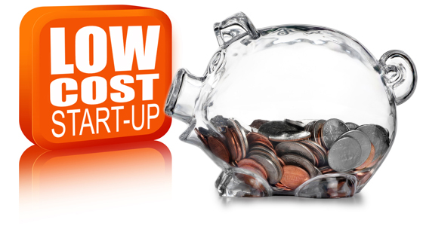

Data Mart Features
Low cost
Easily built
Controlled locally
Contain less information than data warehouse
Rapid response
Easily understood
Within the range of divisional or departmental budgets

Slide 10
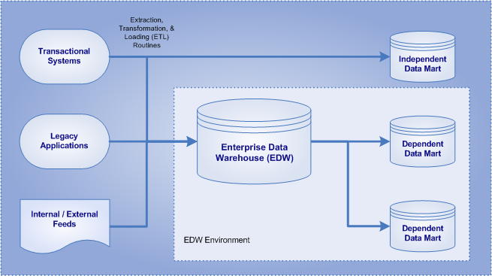
Types of Data Mart based on the data source

Slide 11

Data Marts = Bowl of Spaghetti

Slide 12
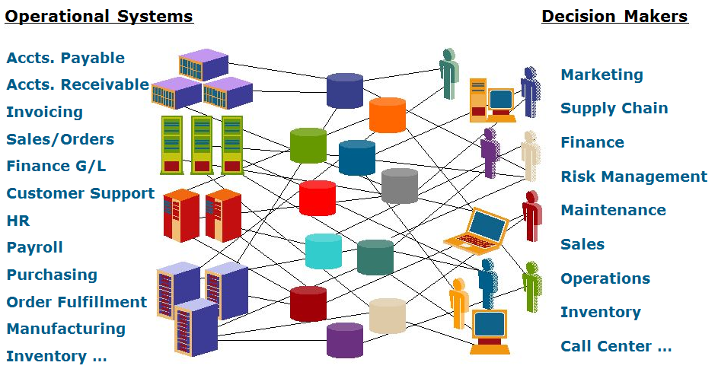
!!!!!

Slide 13
Developing a Data Warehouse/Data Mart
Data Warehouse:
Identify and gather requirements
Design the dimensional model
Develop the architecture, including the Operational Data Store (ODS)
Design the relational database
Develop the data maintenance applications
Develop analysis applications
Test and deploy the system
Data Mart
Designing
Constructing
Populating
Accessing
Managing

Slide 14
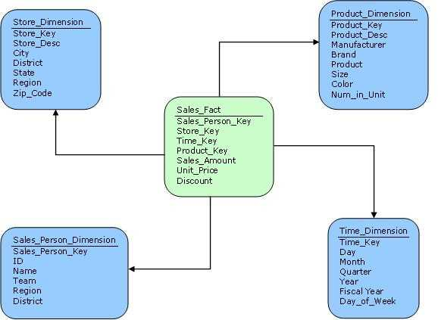
Star Schema
Star Schema provides better performance and smaller query times.
Star Schema is very easy to understand, even for non technical business managers.
Star schema is easily extensible and will handle future changes easily.

Slide 15
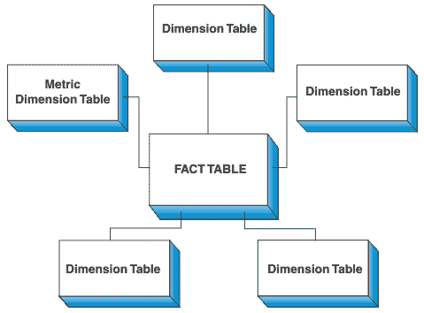
Fact and Dimension Table
Fact Table
Captures the data.
Contains business sales event.
Contains large number of rows.
Contains numerical data.
Sales_Fact Table
Sales_Amount, Unit_Price, Discount
Dimension Table
Contains Attributes.
Describes fact records in the fact table.
Contains hierarchies of attributes to aid summarization.
Customer dimension table contains data about customers.…………

Slide 16
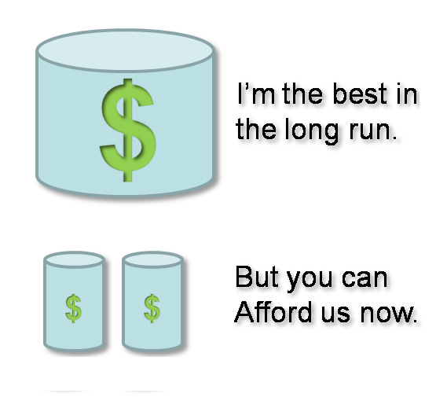
Data Warehouse vs. Data Mart
Category | Data Warehouse | Data Mart
Scope | Corporate | Line of Business (LOB)
Subject | Multiple | Single subject
Data Sources | Many | Few
Size (typical) | 100 GB-TB+ | < 100 GB
Implementation Time | Months to years | Months

Slide 17
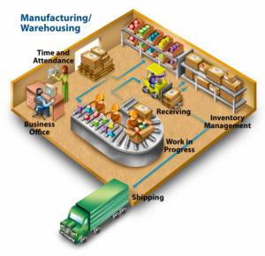
Summary
Data Warehouse/Data Mart
Data mart and data warehousing are tools to assist management to come up with relevant information about the organization at any point of time.
While data marts are limited for use of a department only, data warehousing applies to an entire organization.
Data marts are easy to design and use while data warehousing is complex and difficult to manage.
Data warehousing is more useful as it can come up with information from any department.

